Slide 1
Field Tests
Corinne Smith

Slide 2
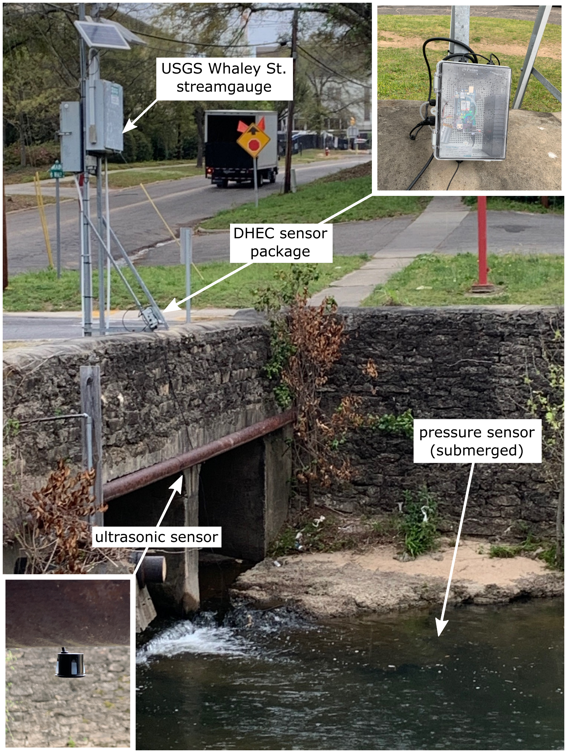
3/31
Fixed on USGS Whaley St streamgage
Ultrasonic sensor was fixed to the pipe, pressure sensor was not fixed
Caused problems to pressure sensor when the flow rate picked up
Solution: deploy pressure sensor to the side of the main flow
Data session: 9:00 – 18:32
Cause of failure: network would not reconnect, so Adafruit IO was completely unresponsive
Possibly encountered a Network Denied status
Ultrasonic had noisy readings between major rainfall periods
Possible something was stuck under the sensor that gave false readings

Slide 3
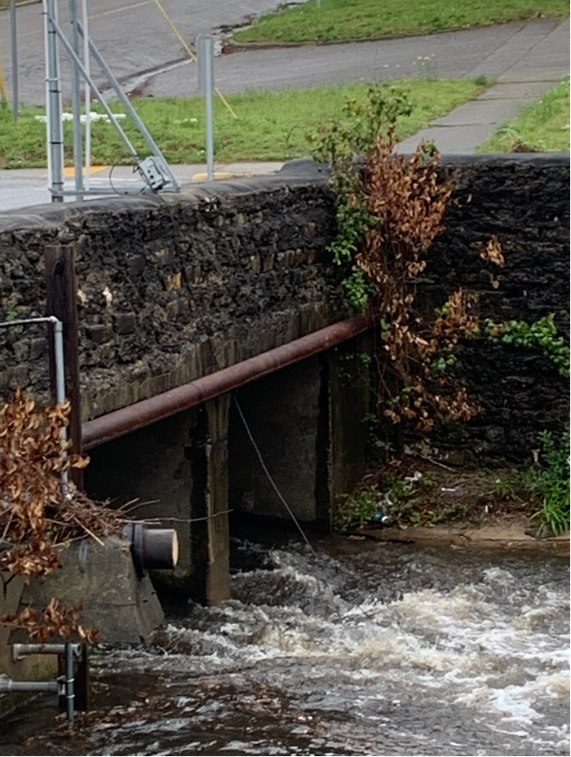
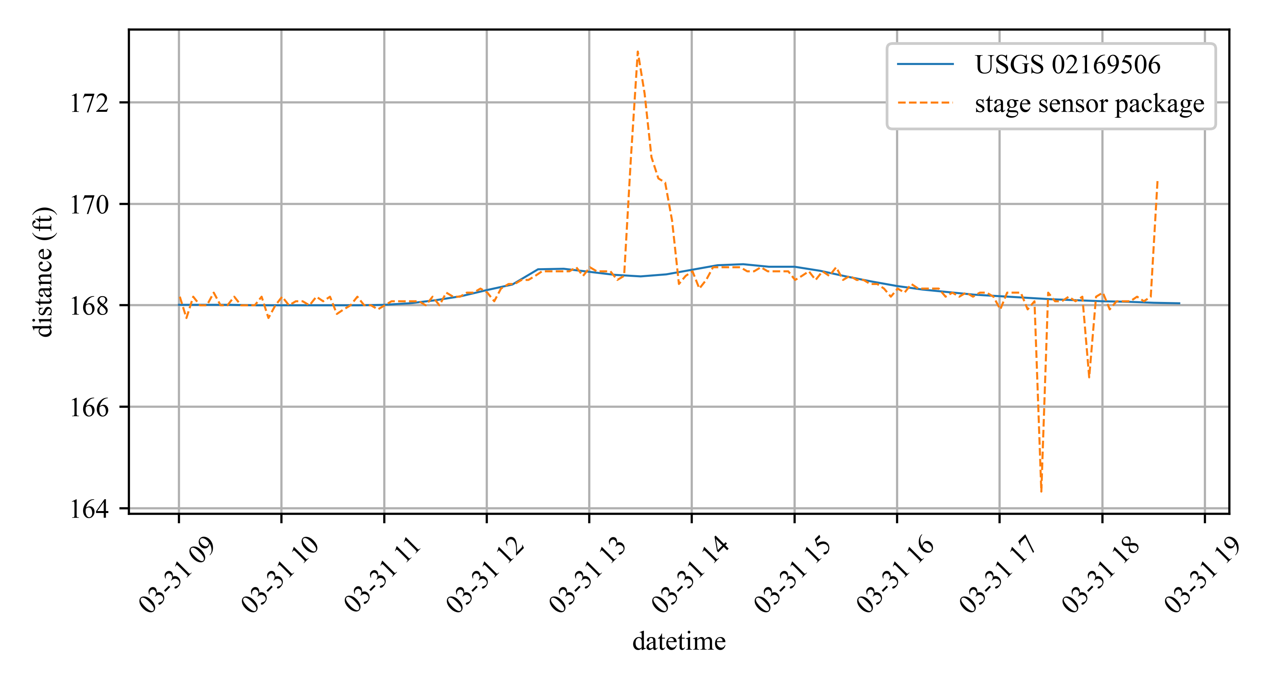
Results

Slide 4
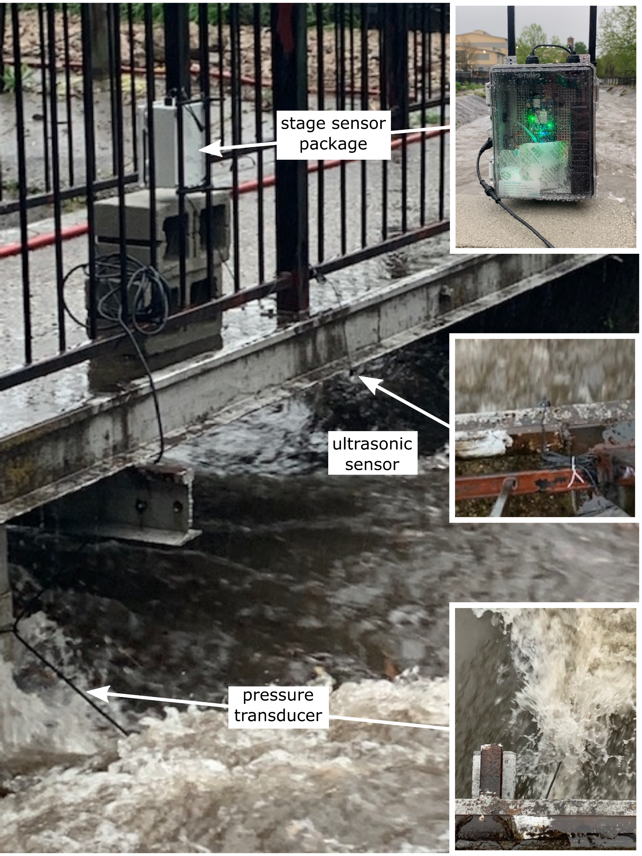
4/5
Severe thunderstorms and tornado warning
Deployed behind 300 Main on bridge
Channel profile differs from USGS; peaks should line up, but magnitude may not
Pressure sensor was secured to bridge leg, ultrasonic sensor was draped over side
Data collection timeframe: 13:50 – 20:42
Cause of failure: waterproofing issues shorted datalogging board
Solution: add glue to further waterproof area around cable glands
Some noisy readings on ultrasonic sensor towards end of deployment
Possible cause: sensor may not be as “waterproof” as datasheet claims

Slide 5
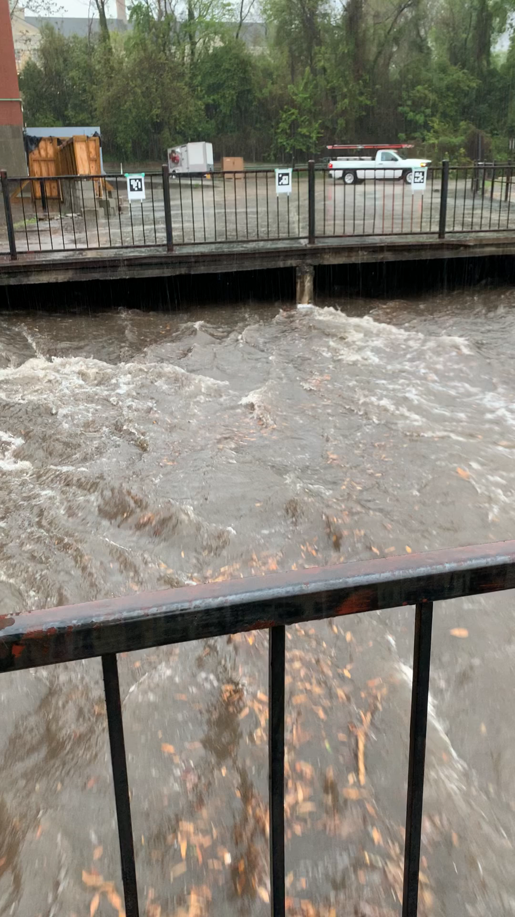
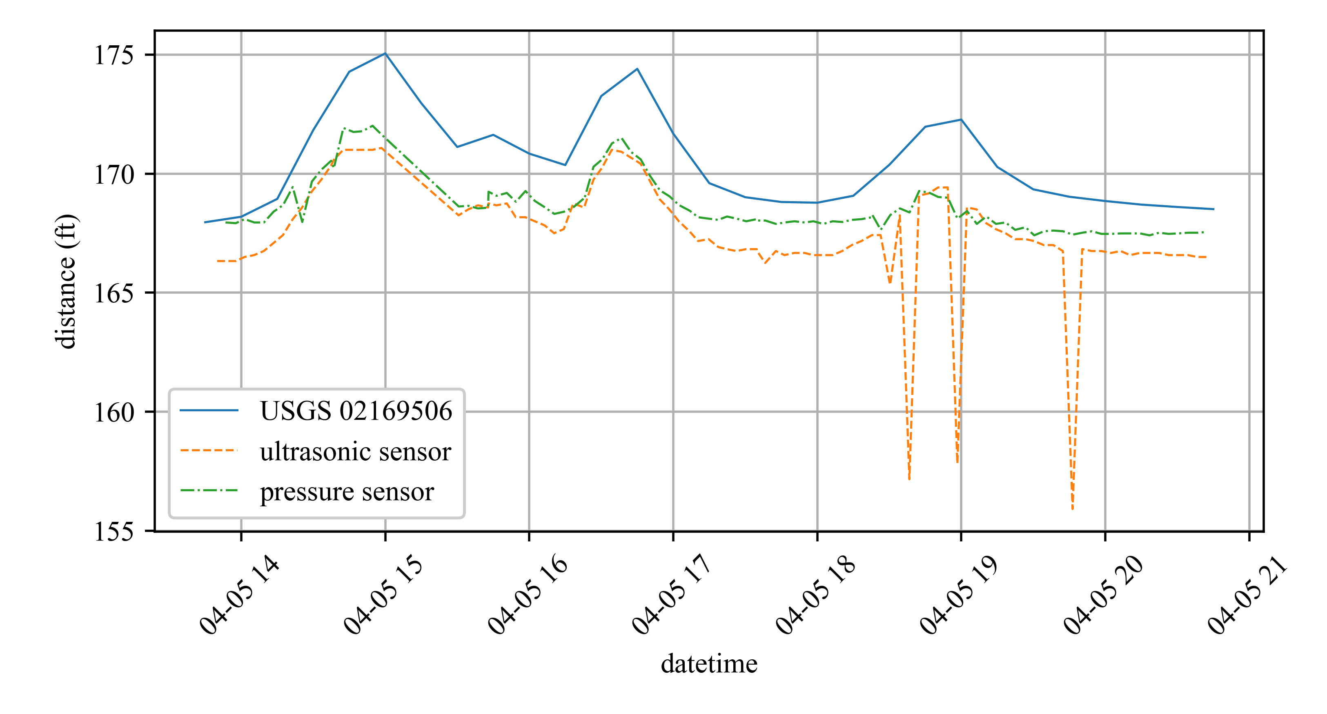
Results

Slide 6
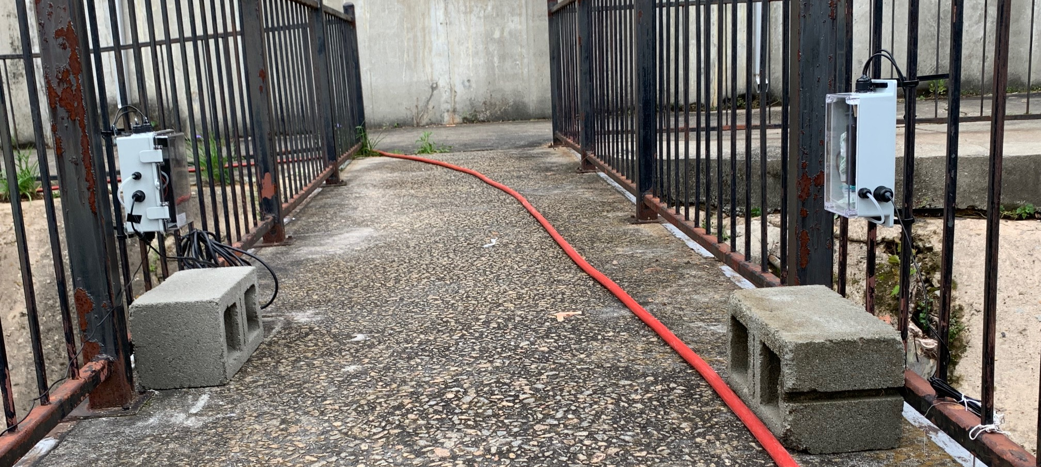
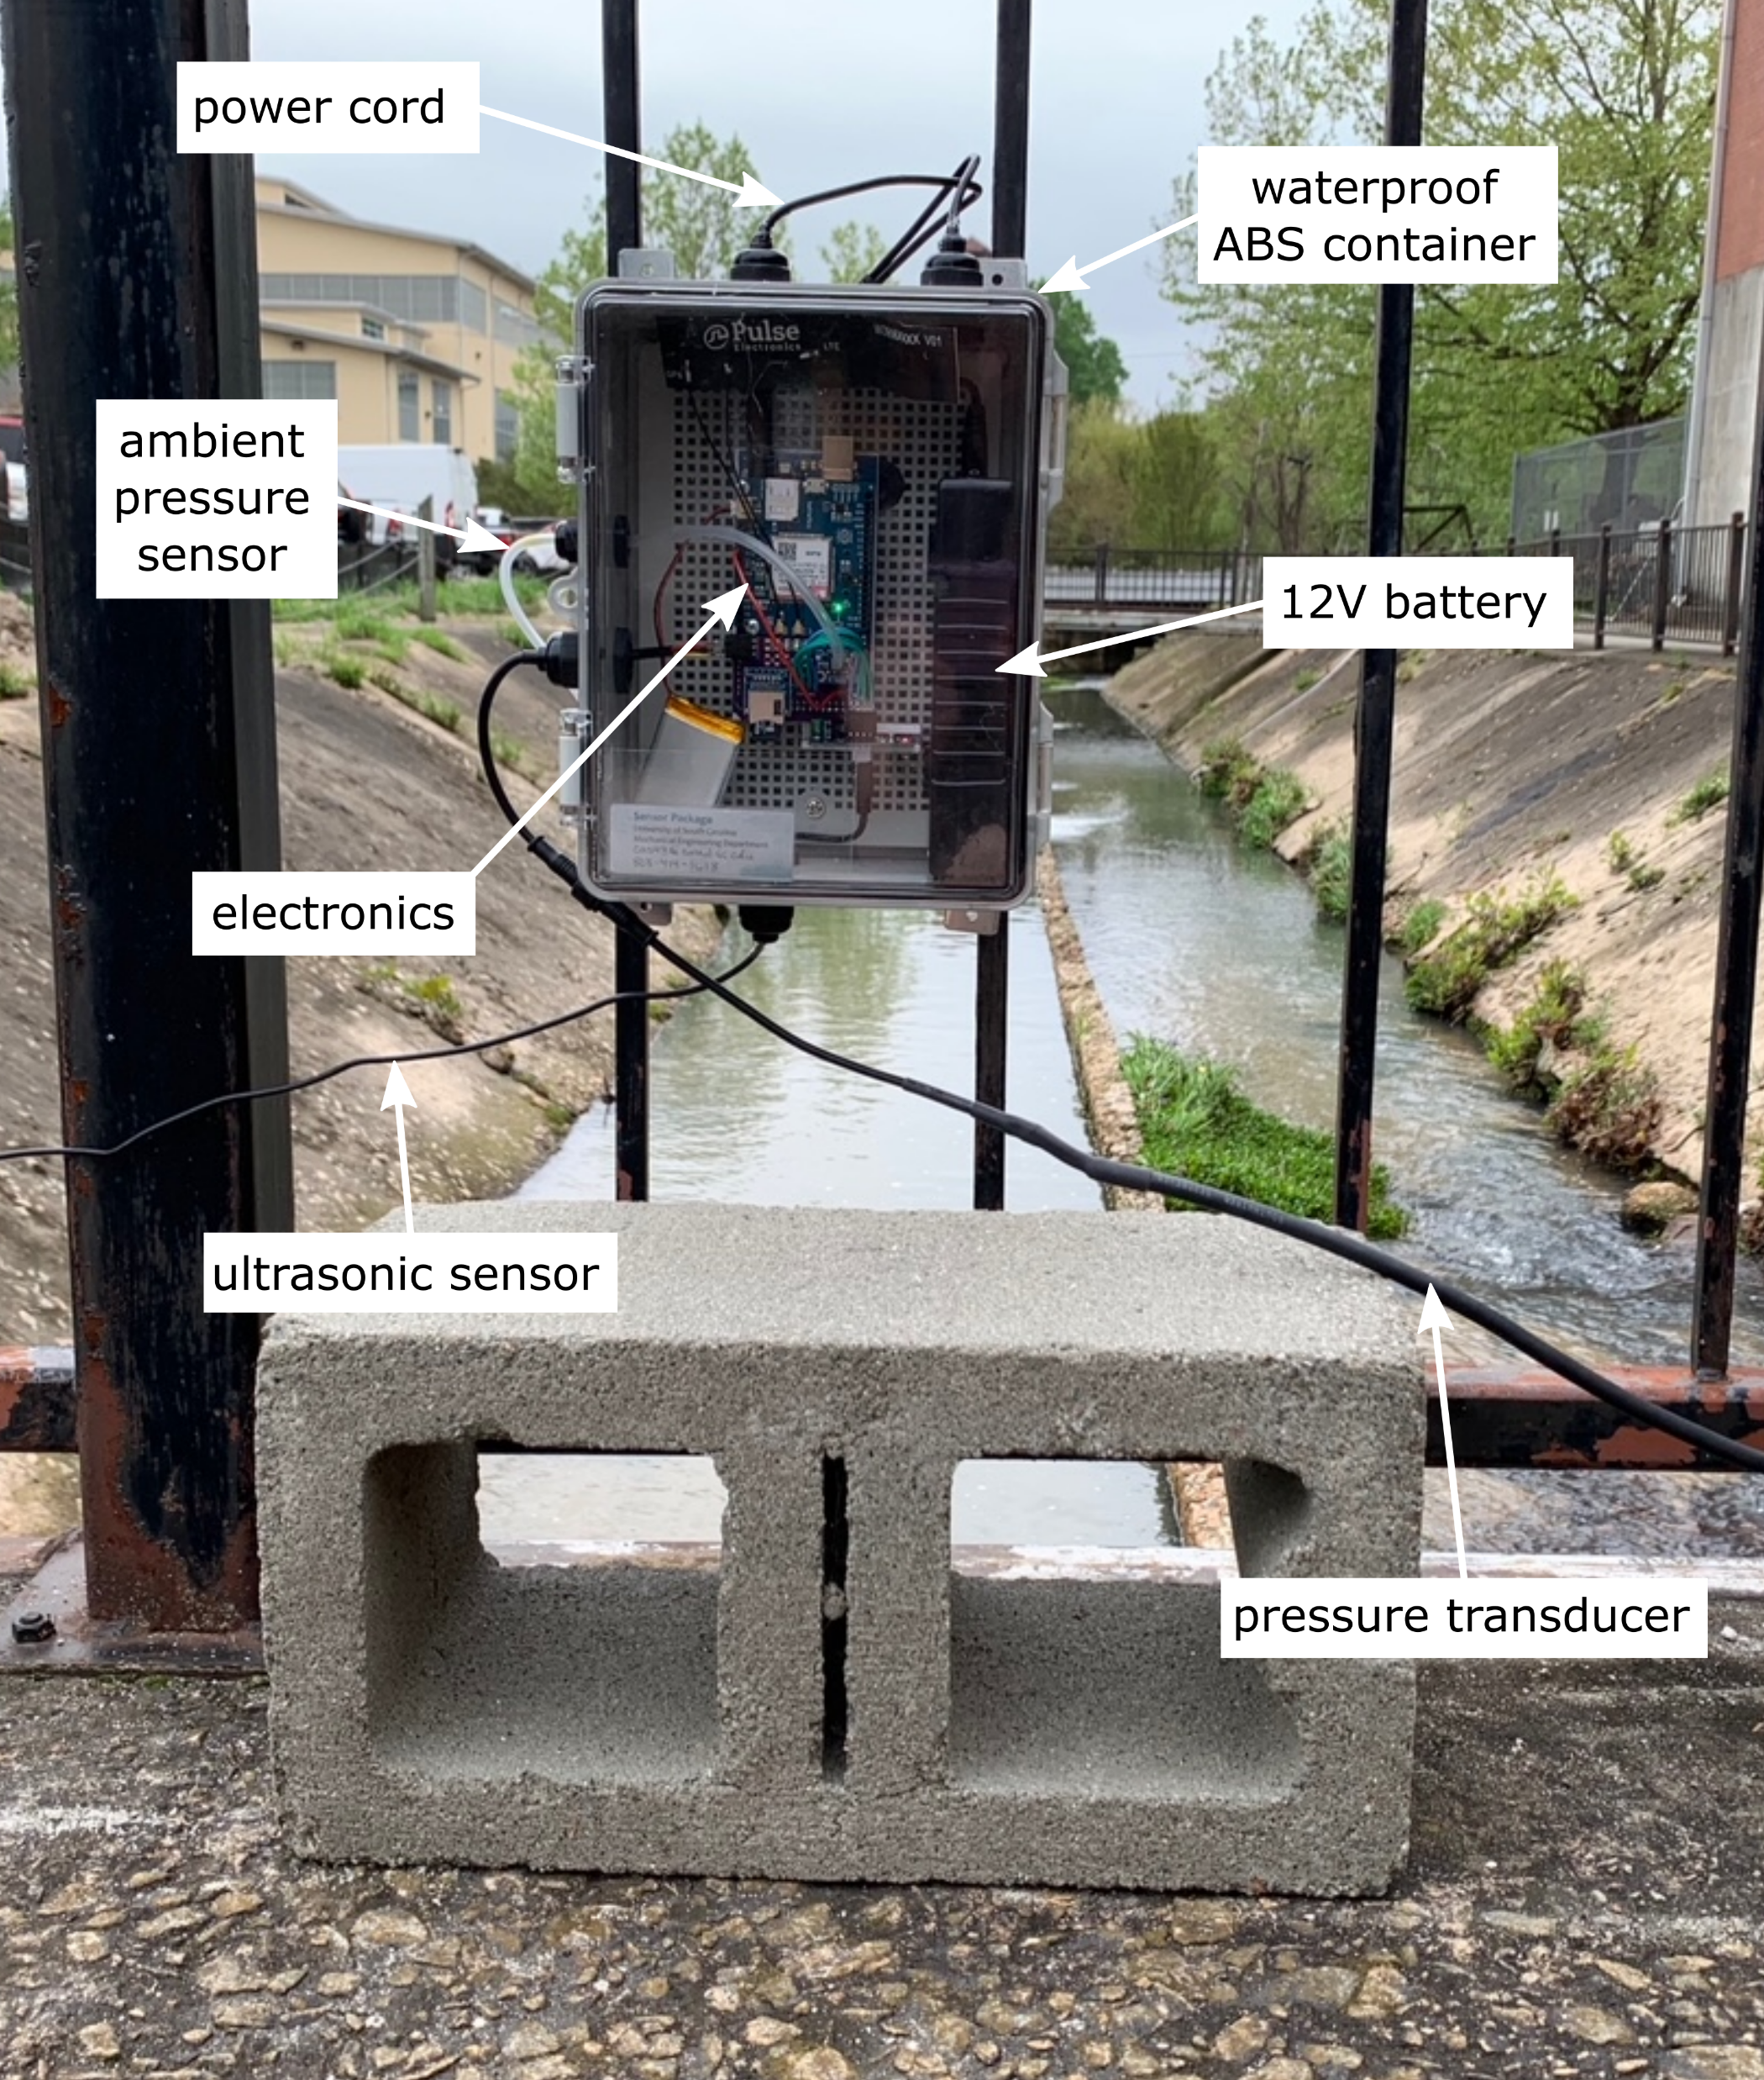
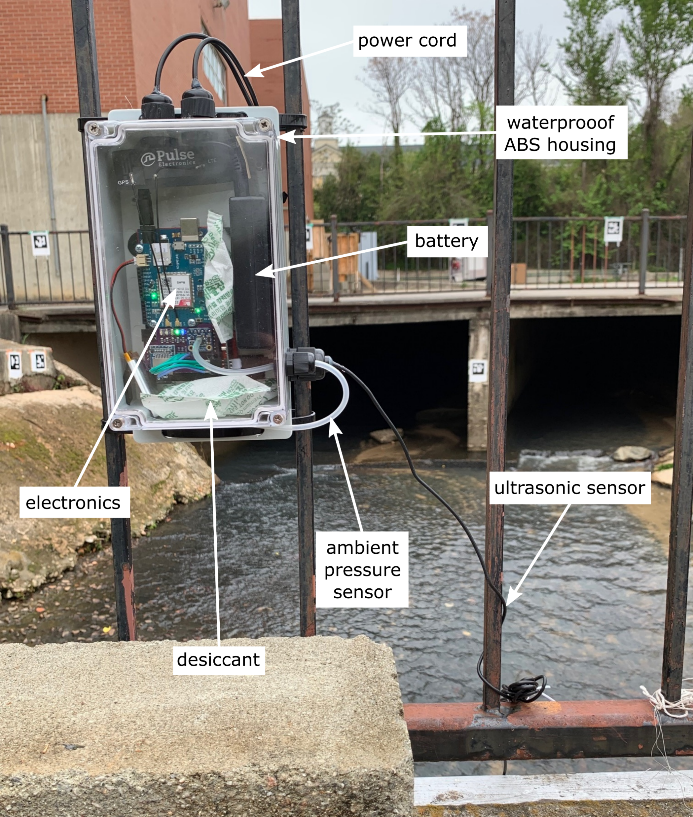
4/6-4/7
Tested fixed sampling package and adaptive sampling package
Fixed sampling:
Readings every 4 minutes
Lasted 4/6 14:10 – 4/7 11:10 (manually stopped)
New ultrasonic sensor kept in makeshift housing to keep it dry
Possible cause of error sensor readings from 4/6 18:30 until 4/7 9:30
Adaptive sampling:
Readings vary between 4 and 20 minutes depending on average second derivatives of readings
Lasted 14:10 – 21:18 due to smaller battery
Noisy readings can accelerate sampling rate
Current equation is too responsive

Slide 7
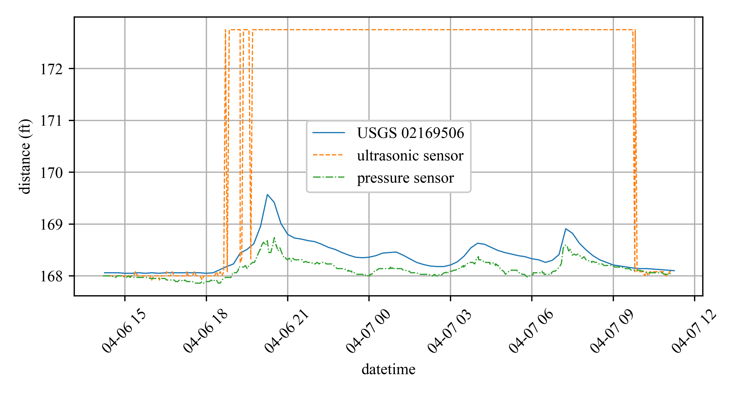
Results

Slide 8
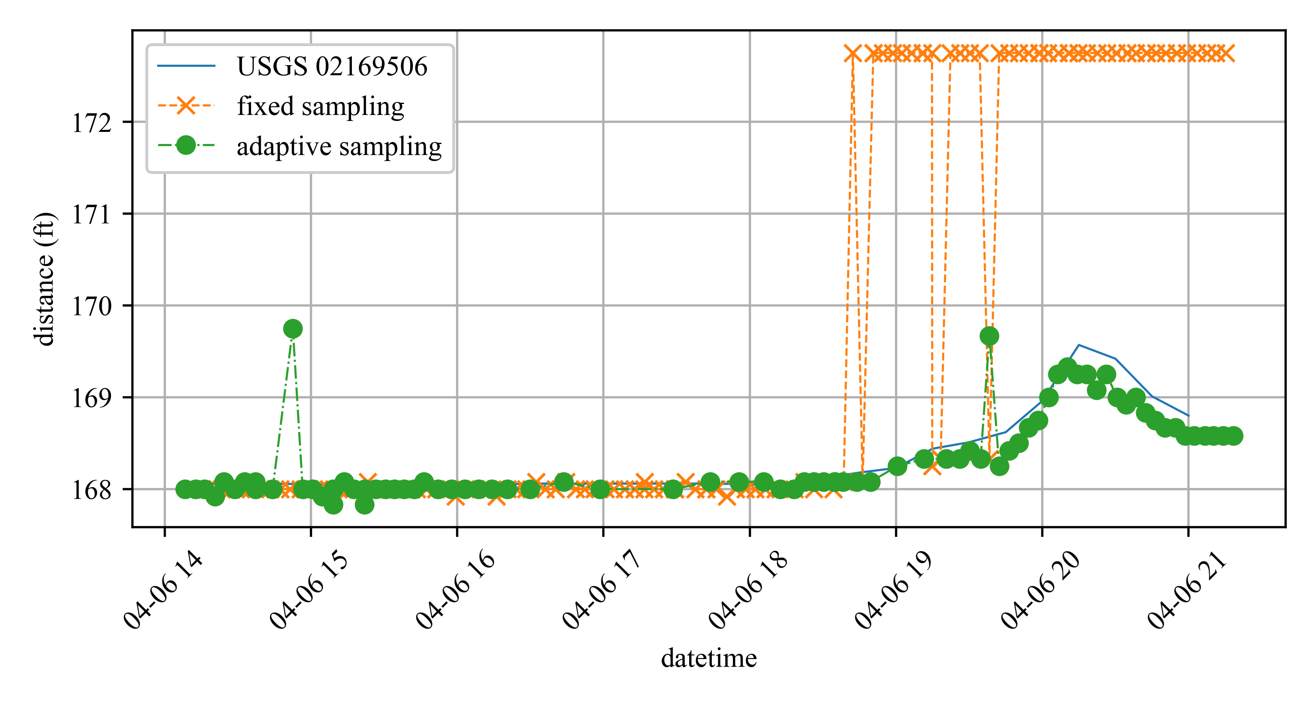
Results

Slide 9
Improvements
Switch to a two-transducer ultrasonic sensor
Two transducers reduces angle spread, which increases accuracy by reducing area that sensor is capturing
Average multiple sensor readings to reduce outliers
Design waterproofing housing for sensor
Make a less responsive time equation (and test more with adaptive sampling package)
Secure pressure transducer and ultrasonic sensor to structure better
Implement a trigger that notifies if readings haven’t been taken after a certain timeframe

